Slide 1
Illusions

Slide 2
Illusions
false or misleading perceptions
help scientists study the processes of perception (e.g., the horizontal-vertical illusion)

Slide 3
Depth Cues
We can use depth cues to understand visual illusions
Or to trick people.

Slide 4
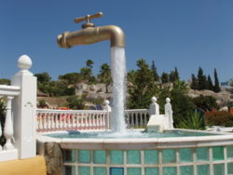

Slide 5
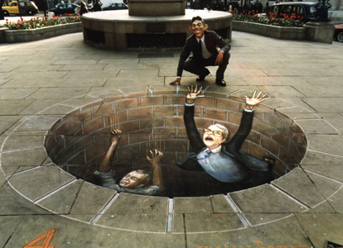

Slide 6
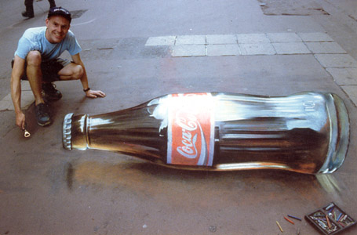

Slide 7
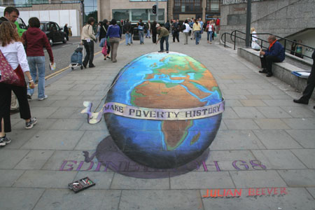

Slide 8
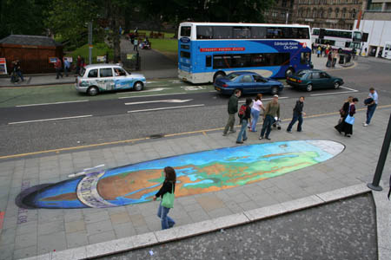

Slide 9
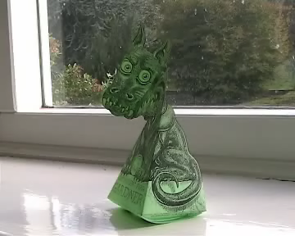

Slide 10
Color Illusions
After effects
Helps explain how color is processed in your eye.

Slide 11
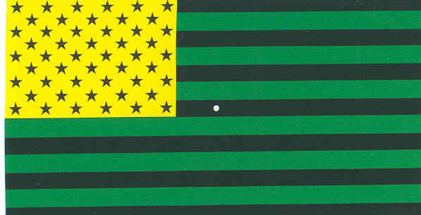
Slide 11-Schiffman Plate 7

Slide 12


Slide 13
Size/Constancy Illusions
Meuller-Lyer
  Most famous and studied illusion.
Ebbinghaus
Moon Illusion
Depth Cues

Slide 14
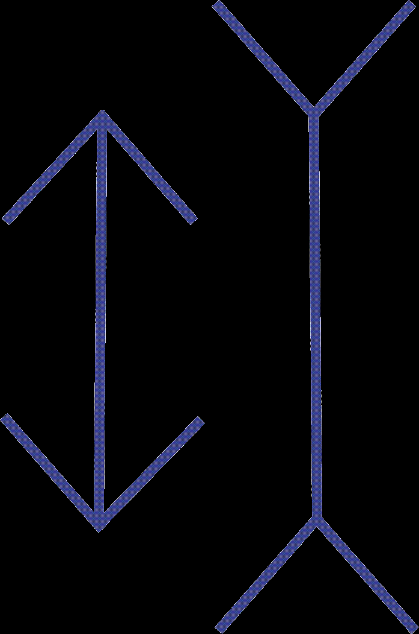

Which one looks bigger?
  Left
  Right

Slide 15
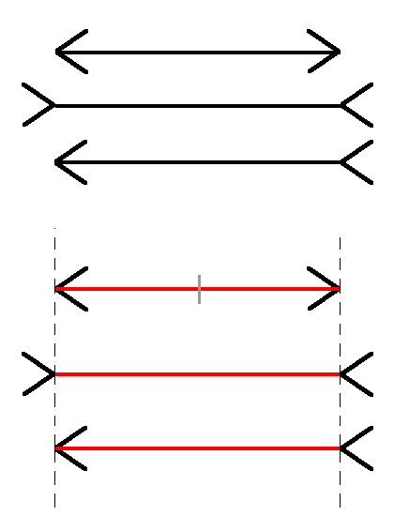

Slide 16
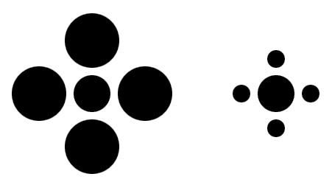
Which one looks bigger?
  Left
  Right

Slide 17
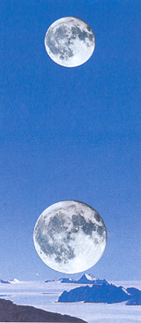
Is the moon bigger at the:
Horizon
Up in the sky

Slide 18
bboard50

Slide 19
Which depth cue is this?
Light and shadow
Aerial perspective
Linear perspective
Occlusion

Slide 20
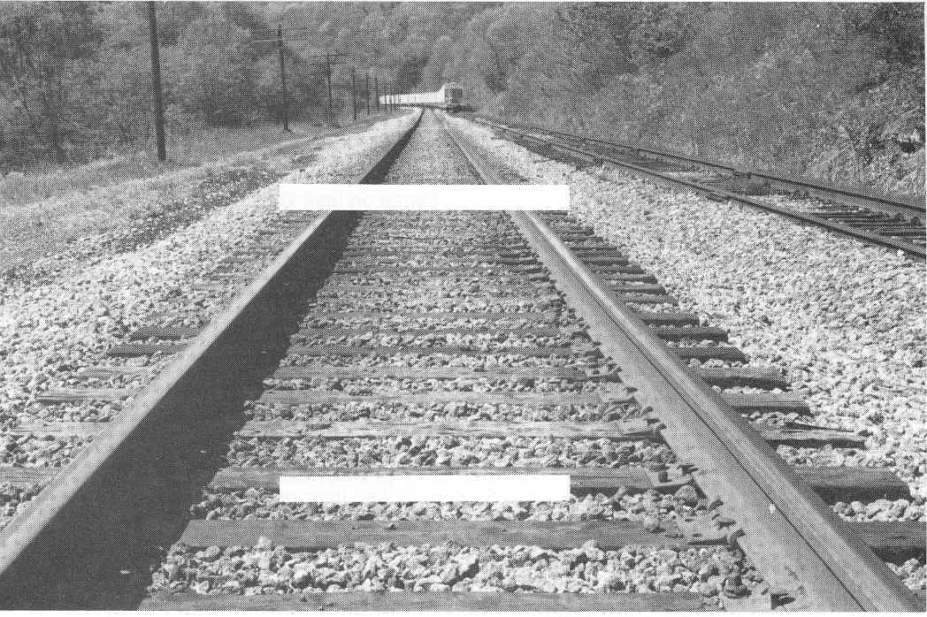
Slide 57-Goldstein Figure 7.39

Slide 21
Motion Illusions
Biological Motion
After motion
Nystagmus
Lilac Chaser (also color illusion)
Cube Rotation

Slide 22

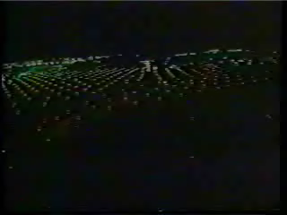

Slide 23
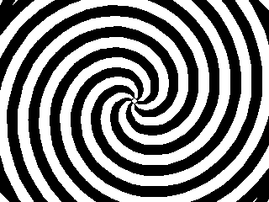

Slide 24


Slide 25
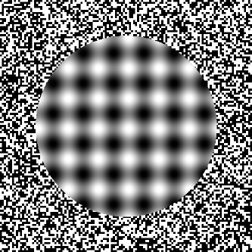

Slide 26
Why should our eyes jitter in our head?
Because otherwise we’ll stop seeing things.
To keep them awake.
To make retinal disparity work.
No good reason, they just do.

Slide 27
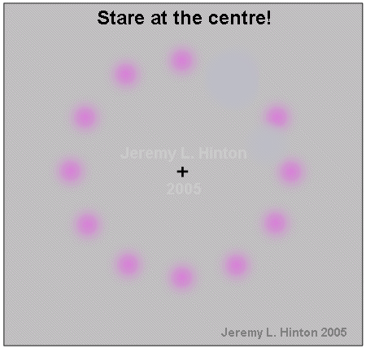

Slide 28
What other process does this show?
Aftereffects
Color processing
Depth Cues
Motion on-off cells

Slide 29
Contrast Illusions
Inset Squares
Shading

Slide 30
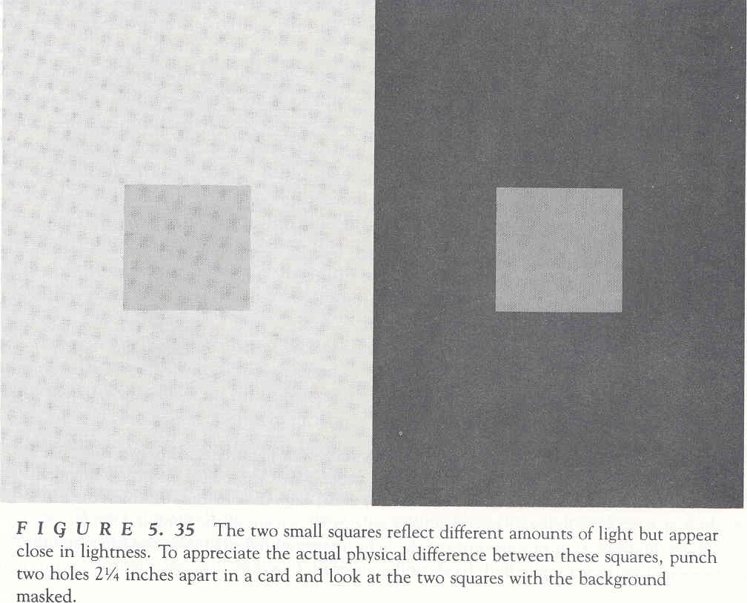
Slide 53-Goldstein Figure 5.35

Slide 31
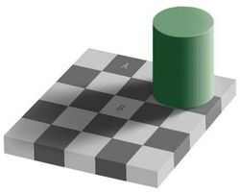

Slide 32
Face Illusions
Bean Face
Inverted Faces

Slide 33
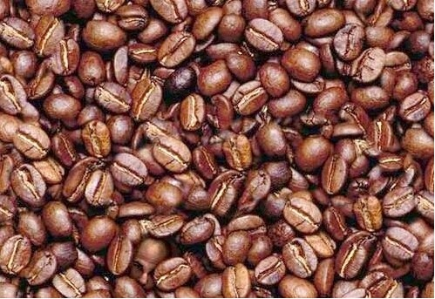

Slide 34
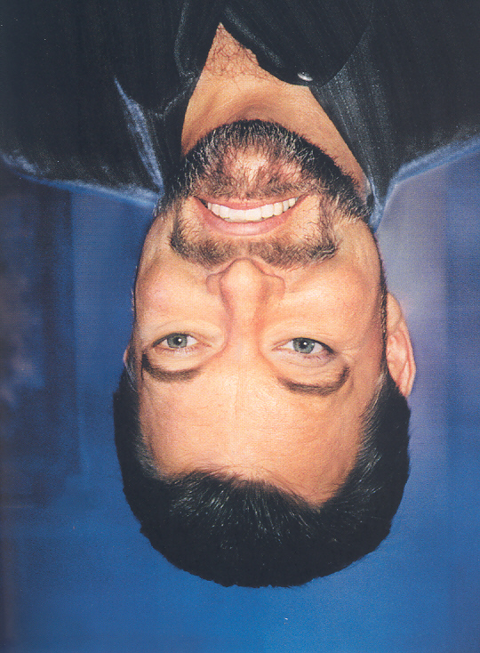
Slide 109b--Seckel-Page 209

Slide 36
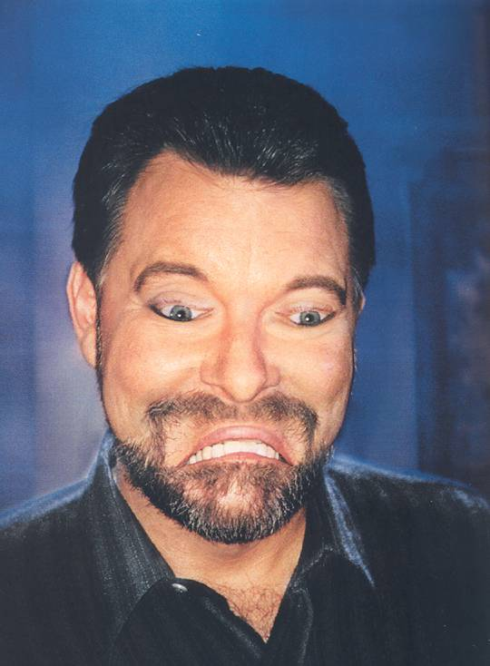
Slide 109C--Seckel-Page 209 Flipped

Slide 37
Ames
A whole set of illusions.
Rectangularity assumption
  See video!

